Slide 1

Sauce & Spoon tablet roll out
Impact Report

Slide 2

Executive Summary
To achieve our growth and expansion goals, Sauce & Spoon installed tabletop tablet menus at the Downtown and North locations, going live on October 15. After sourcing and installing the tablets, training staff, and a successful test run, we launched a pilot and gathered customer feedback via surveys on the devices. Based on this feedback, we made operational improvements, including ongoing staff training, tablet audits, and investigating food waste.
Since the official launch, we’ve seen a 10% increase in daily guest count, a 30-minute reduction in wait times, a one-minute checkout process, and a 50% decrease in food waste. Sales have risen by 20%, and customer satisfaction has improved from 72% to 86%. We will continue to make improvements as we consider expanding the tablet rollout to other locations.

Slide 3
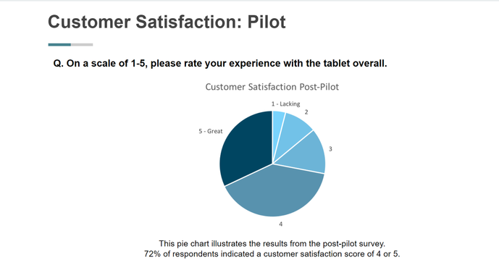

Slide 4
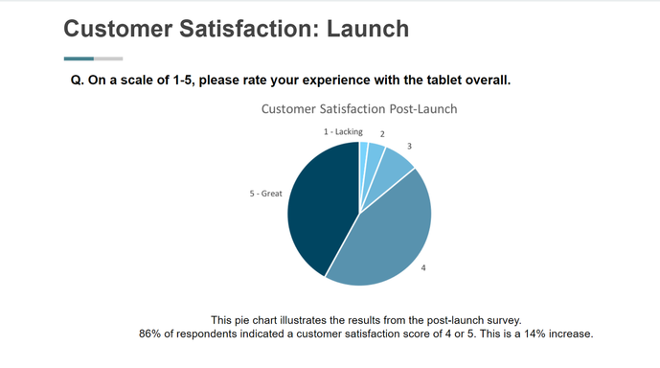

Slide 5
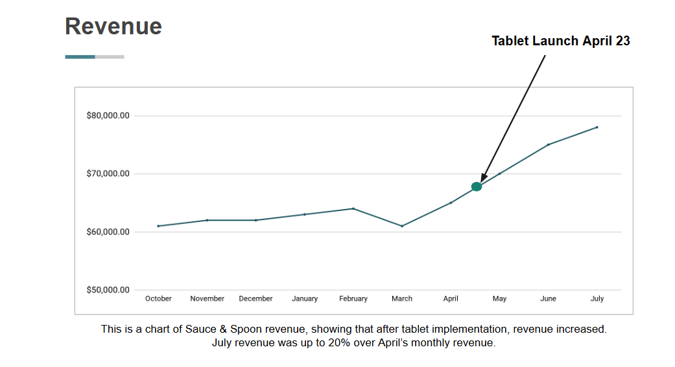

Slide 6
Key Accomplishments
Enhanced Customer Satisfaction: The introduction of tablets in two restaurant locations resulted in a 14% boost in customer satisfaction.
Revenue Increase: Monthly revenue grew by 20%, thanks to improved efficiency and customer experience.
Faster Table Turnover: The average time to turn tables decreased, enabling the restaurant to serve more guests.
Shorter Wait Times: Wait times were reduced by an average of 30 minutes, enhancing the overall dining experience.
Less Food Waste: The tablets helped identify incorrect orders, leading to a 50% reduction in food waste.

Slide 7
Next steps going forward
Initiative | Action | Date
Review Current Implementation | Re-assess the tablet implementation in the bar section to identify any issues or areas for improvement before expanding to other sections. | Q2
Conduct Risk Assessment | Carry out a risk assessment to understand the operational risks of a full rollout and develop strategies to mitigate them. | Q2
Establish Feedback Loop | Set up a continuous feedback loop to gather input from both customers and staff, allowing for necessary adjustments. | Continuous
Revise Training | Update the current training program to emphasize communication between front-of-house and kitchen staff, as well as operational processes. | Q2

